Slide 1

COMPUTER ORGANIZATION AND ARCHITECTURE
21CSS201T [3 Credits]
II Year_III Semester
Department of Networking and Communications
School of Computing

Slide 2
Course Objectives
Understand the Fundamentals of computers, Memory operations and Addressing Modes.
Know about Functions of Arithmetic and Logic Unit.
Explore the Operations of Control unit, Execution of instruction and Pipelining.
Classify the Need of Parallelism, Multicore and Multiprocessor systems.
Understand the concepts and functions of Memory unit, I/O unit.

Slide 3
Course Outcomes
Identify the Computer hardware and how software interacts with computer hardware
Apply Boolean algebra as related to designing computer logic, through simple combinational and sequential logical circuits
Examine the detailed operation of basic processing units and the performance of pipelining
Analyze concept of parallelism and multicore processors
Classify the memory technologies , input and output systems and evaluate the performance of memory systems

Slide 4
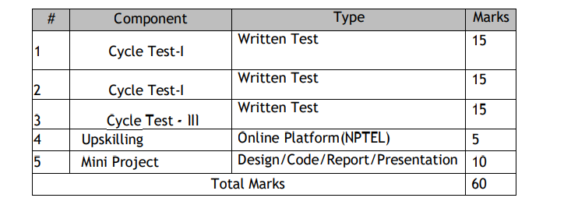
Overall Assessment Plan

Slide 5
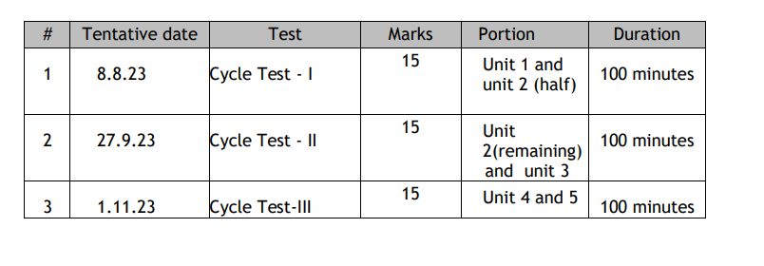
Tentative Test Plan

Slide 6
List of Topics:
Introduction to Number System and Logic Gates:
Number Systems- Binary, Decimal, Octal, Hexadecimal;
Codes- Grey, BCD,Excess-3, ASCII, Parity;
Binary Arithmetic- Addition, Subtraction, Multiplication, Division using Sign Magnitude,1’s compliment, 2’s compliment, BCD Arithmetic;
Logic Gates-AND, OR, NOT, NAND, NOR, EX-OR, EX-NOR.

Slide 7
Computer architecture
Focuses on the structure(the way in which the components are interrelated) and behavior of the computer system and refers to the logical aspects of system implementation as seen by the programmer
Computer architecture includes many elements such as
instruction sets and formats, operation codes, data types, the number and types of registers, addressing modes, main memory access methods, and various I/O mechanisms.
The architecture of a system directly affects the logical execution of programs.
The computer architecture for a given machine is the combination of its hardware components plus its instruction set architecture (ISA).
The ISA is the interface between all the software that runs on the machine and the hard
Studying computer architecture helps us to answer the question: How do I design a computer?

Slide 8
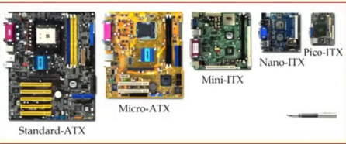
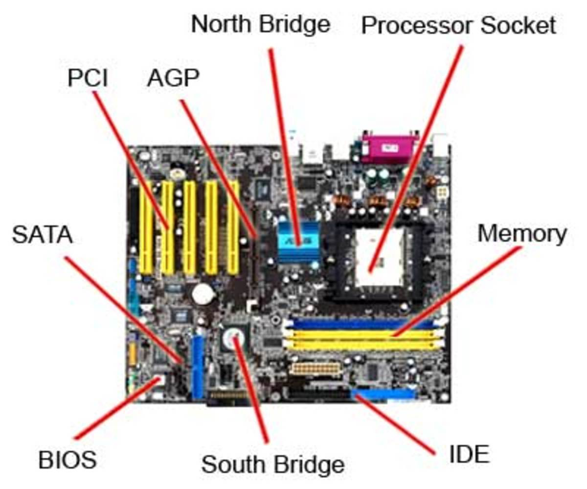

Slide 9
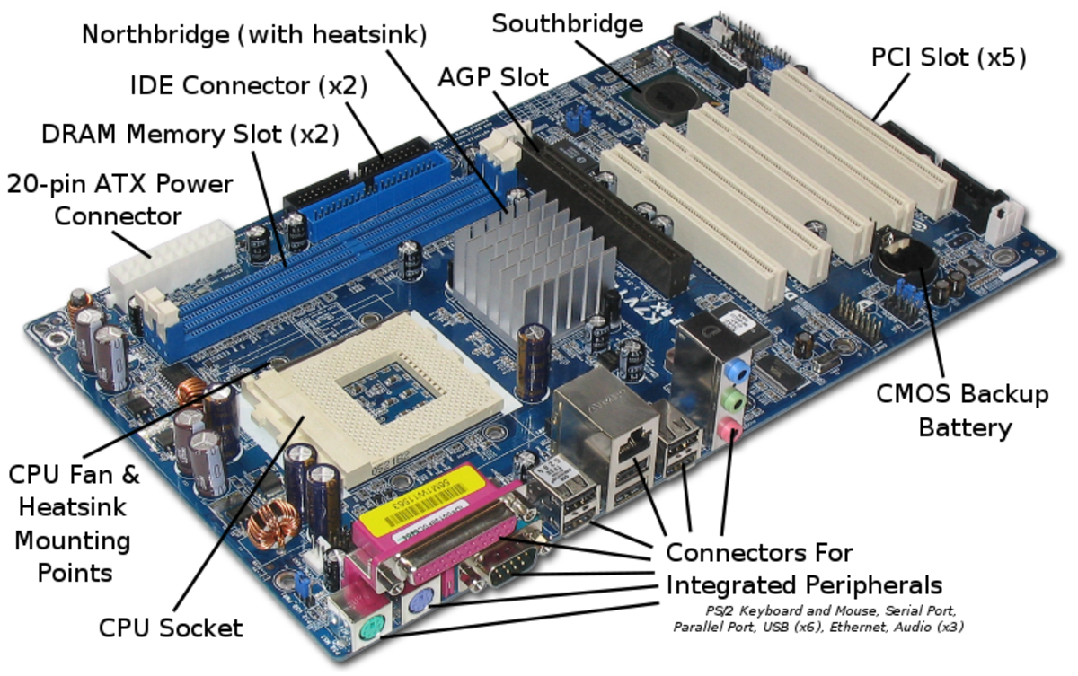

Slide 10
Parts of Motherboard – Printed Circuit board
The Computer's Microprocessor – Computers brain
Random Access Memory (RAM) – Computer chip that generally store data (dynamic/ temporary)
Basic Input/Output System (BIOS) – read only memory
Complimentary Metal Oxide Semiconductor Random Access Memory (CMOS RAM) – small separate block of memory from this chip
The Computer Cache Memory – Small block of high speed memory (RAM)
The Expansion Buses – ip/op pathway [PCI, Peripheral Component Interconnect] – signals memory control units
The Computer Chipsets – Small circuits (flow of data)
North bridge – Memory controller,
south bridge – input output controller)
The CPU Clock

Slide 11
Need of COA
Understanding of the design of fundamental blocks used for building a computer system and interfacing techniques of these blocks to achieve different configurations of an “entire computer system”.
Computer systems become essential part of our life:
Laptop, Mobile phone, intelligent appliances
What is inside computers?
How does it work?

Slide 12
Need of COA
Computer Organization:
Design of the components and functional blocks using which computer systems are built
Eg: Civil engineer: Cement, bricks and sand..,
Computer architecture:
How to integrate the components to build a computer system to achieve a desired level of performance
Eg: Architect – task during the planning of the building (layout, floorplan ..,)

Slide 13
UNIT I INTRODUCTION TO NUMBER SYSTEM AND LOGIC GATES

Slide 14
NUMBER SYSTEMS

Slide 15
Computers only understand the numbers.
So, when we enter data, the data is converted into electronic pulse.
Each pulse is identified as code and the code is converted into numeric format by ASCII.
It gives each number, character and symbol a numeric value (number) that a computer understands.
The most common encoding scheme for characters is ASCII (American Standard Code for Information Interchange).
So to understand the language of computers, one must be familiar with the number systems.

Slide 16
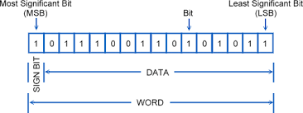
A number N in base or radix b can be written as:
(N)_{b} = d_{n-1} d_{n-2} -- -- -- -- d₁ d₀ . d₋₁ d₋₂ -- -- -- -- d_{-m}
In the above, d_{n-1} to d₀ is the integer part, then follows a radix point, and then d₋₁ to d_{-m} is the fractional part.
d_{n-1} = Most significant bit (MSB) d_{-m} = Least significant bit (LSB)

Slide 17
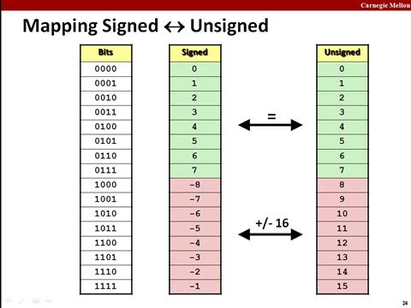
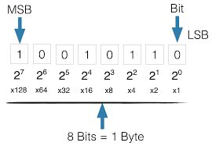

Slide 18
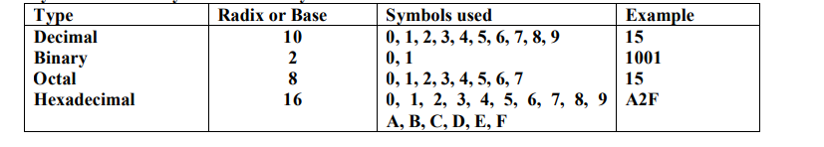
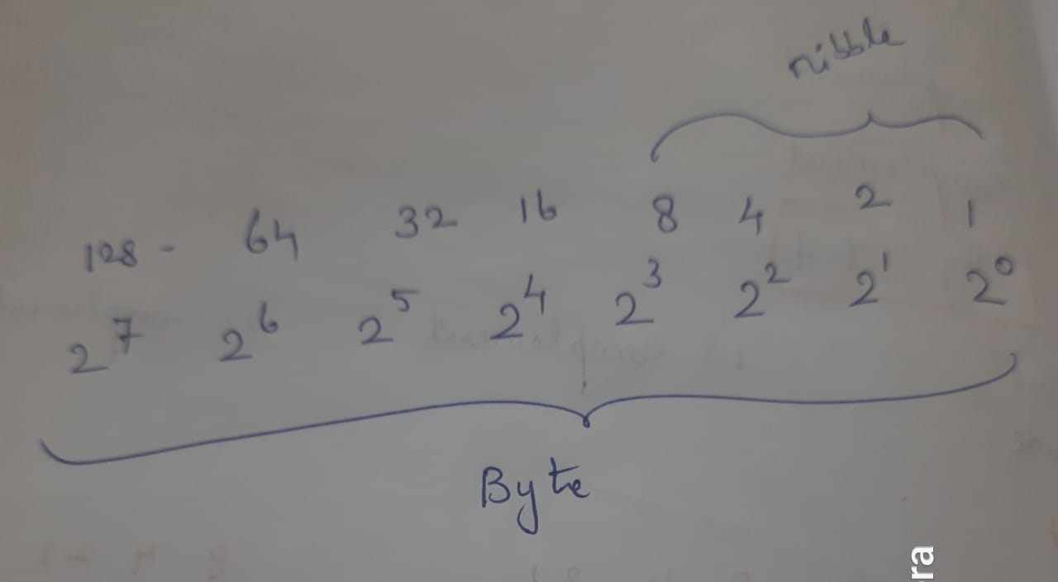
The radix or base of a number system is the number of digits or basic symbols used in that system

Slide 19
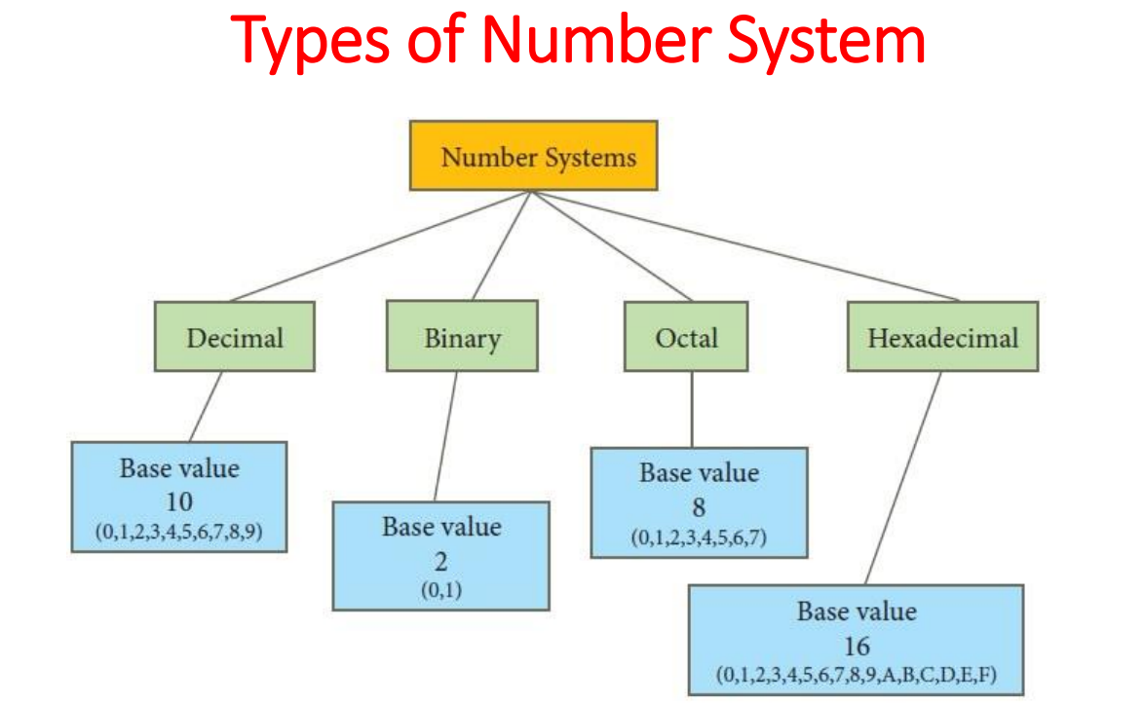
I. TYPES OF NUMBER SYSTEM

Slide 20
Binary number system
It has only two digits '0' and '1' so its base is 2. Accordingly, In this number system, there are only two types of electronic pulses;
Absence of electronic pulse which represents '0’ and presence of electronic pulse which represents ‘1’.
Each digit is called a bit. A group of four bits (1101) is called a nibble and group of eight bits (11001010) is called a byte.
The position of each digit in a binary number represents a specific power of the base (2) of the number system.

Slide 21
Octal number system
It has eight digits (0, 1, 2, 3, 4, 5, 6, 7) so its base is 8.
Each digit in an octal number represents a specific power of its base (8).
This number system is also used to shorten long binary numbers. The three binary digits can be represented with a single octal digit.

Slide 22
Decimal number system
This number system has ten digits (0, 1, 2, 3, 4, 5, 6, 7, 8, 9) so its base is 10.
In this number system, the maximum value of a digit is 9 and the minimum value of a digit is 0.
The position of each digit in decimal number represents a specific power of the base (10) of the number system.
This number system is widely used in our day to day life.
It can represent any numeric value

Slide 23
Hexadecimal number system
This number system has 16 digits that ranges from 0 to 9 and A to F. So, its base is 16.
The A to F alphabets represent 10 to 15 decimal numbers.
The position of each digit in a hexadecimal number represents a specific power of base (16) of the number system.
As there are only sixteen digits, four bits (24=16) of binary number system can convert any hexadecimal number into binary number.
It is also known as alphanumeric number system as it uses both numeric digits and alphabets

Slide 24

1. Binary Number system
A binary number system is a code that uses only two basic symbols.
The digits can be any two distinct characters, but it should be 0 or 1.

Slide 25
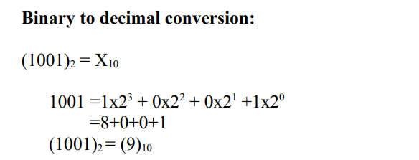
BINARY TO DECIMAL CONVERSION

Slide 26
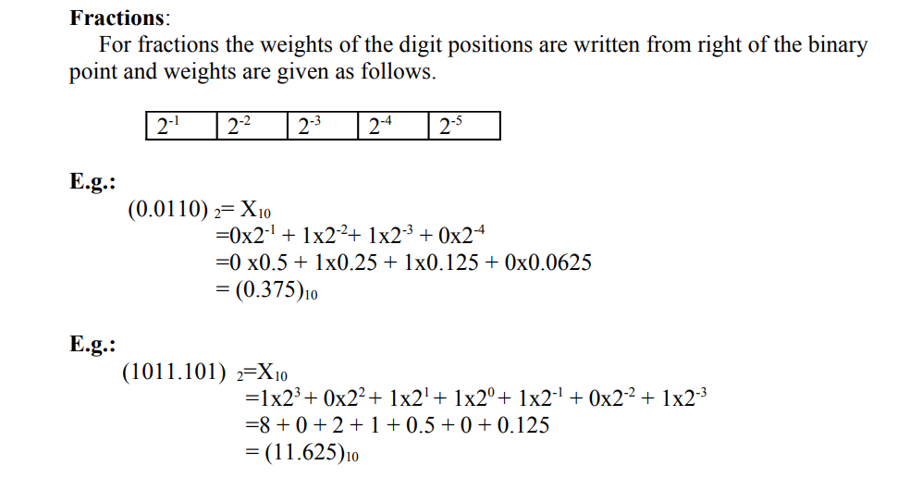
BINARY TO DECIMAL CONVERSION

Slide 27
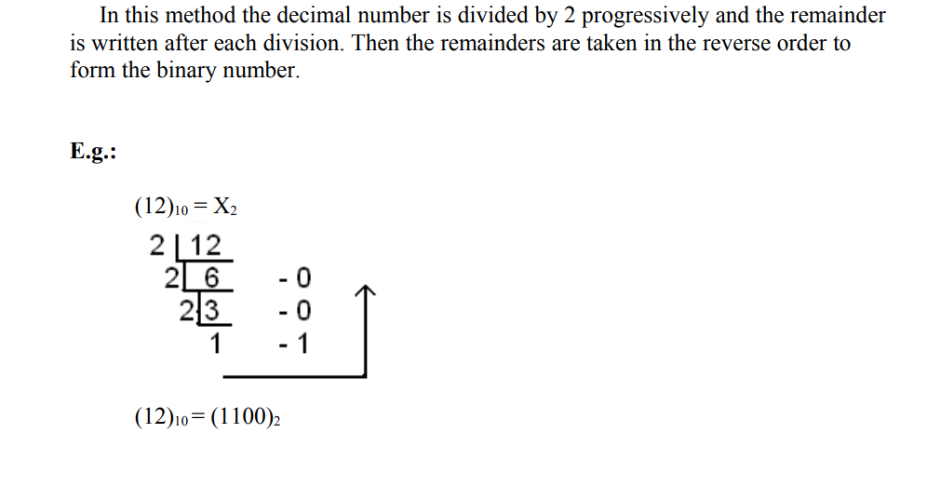
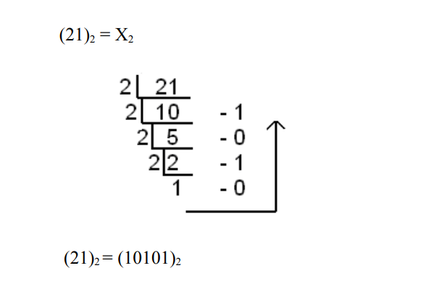
DECIMAL TO BINARY CONVERSION

Slide 28
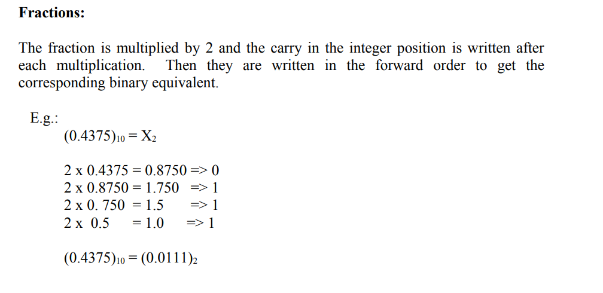
DECIMAL TO BINARY CONVERSION

Slide 29
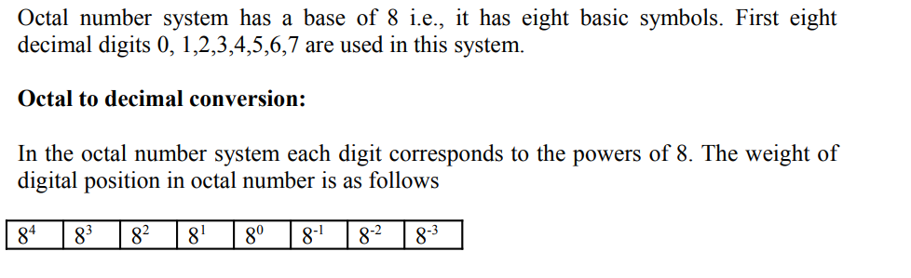
2.OCTAL NUMBER SYSTEM
To convert from octal to decimal multiply each octal digit by its weight and add the resulting products.

Slide 30
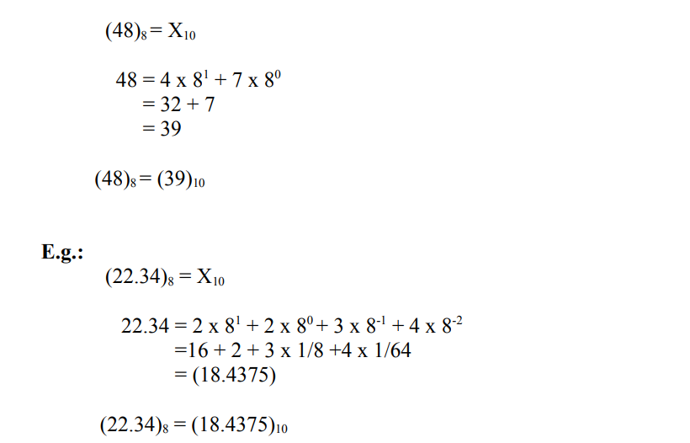
OCTAL TO DECIMAL NUMBER CONVERSION
To convert from octal to decimal multiply each octal digit by its weight and add the resulting products.

Slide 31
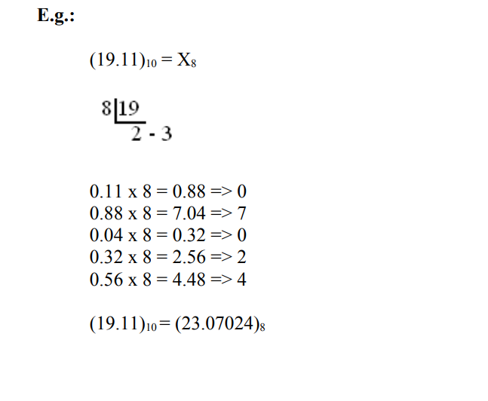
DECIMAL TO OCTAL NUMBER CONVERSION
Here the number is divided by 8 progressively and each time the remainder is written and finally the remainders are written in the reverse order to form the octal number.
If the number has a fraction part, that part is multiplied by 8 and carry in the integer part is taken. Finally the carries are taken in the forward order

Slide 32
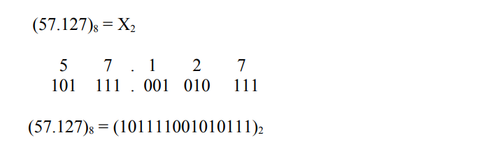
OCTAL TO BINARY NUMBER CONVERSION
 | 4 | 2 | 1
5 | 1 | 0 | 1
7 | 1 | 1 | 1
1 | 0 | 0 | 1
2 | 0 | 1 | 0
7 | 1 | 1 | 1

Slide 33
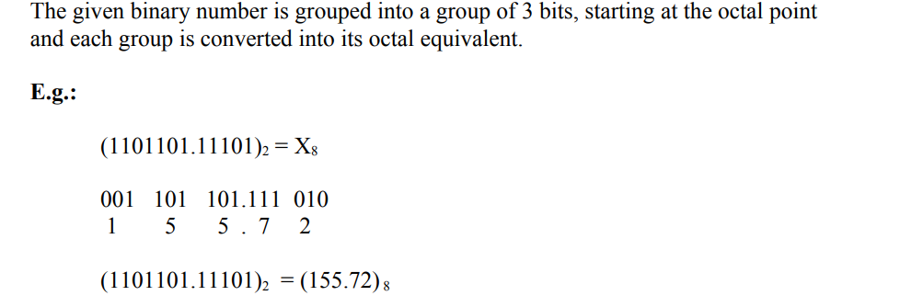
BINARY TO OCTAL NUMBER CONVERSION
 | 4 | 2 | 1
1 | 0 | 0 | 1
5 | 1 | 0 | 1
5 | 1 | 0 | 1
7 | 1 | 1 | 1
2 | 0 | 1 | 0

Slide 34
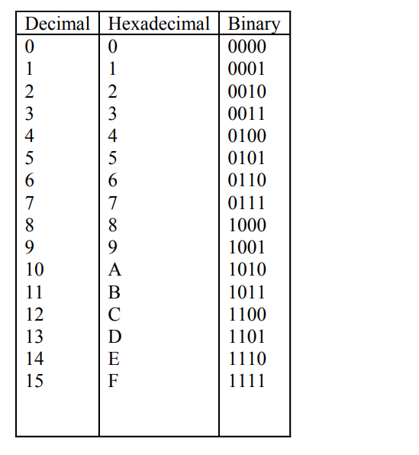
3. HEXADECIMAL NUMBER SYSTEM

Slide 35
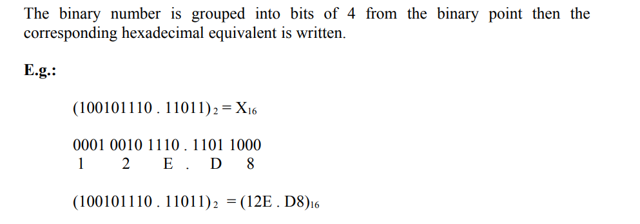
BINARY TO HEXADECIMAL NUMBER CONVERSION
 |  | 8 | 4 | 2 | 1
1 |  | 0 | 0 | 0 | 1
2 |  | 0 | 0 | 1 | 0
E | 14 | 1 | 1 | 1 | 0
D | 13 | 1 | 1 | 0 | 1
8 |  | 1 | 0 | 0 | 0

Slide 36
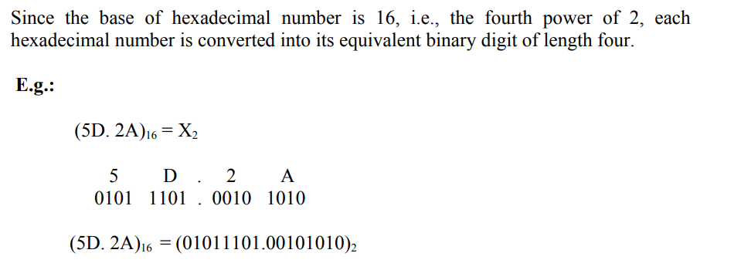
HEXADECIMAL TO BINARY NUMBER CONVERSION
 |  | 8 | 4 | 2 | 1
5 |  | 0 | 1 | 0 | 1
D | 13 | 1 | 1 | 0 | 1
2 |  | 0 | 0 | 1 | 0
A | 10 | 1 | 0 | 1 | 0

Slide 37
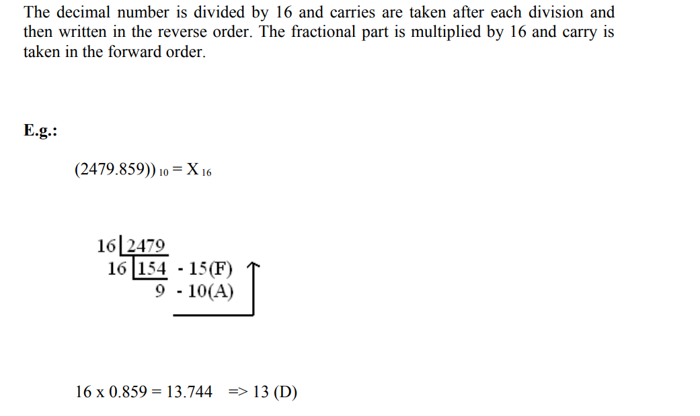
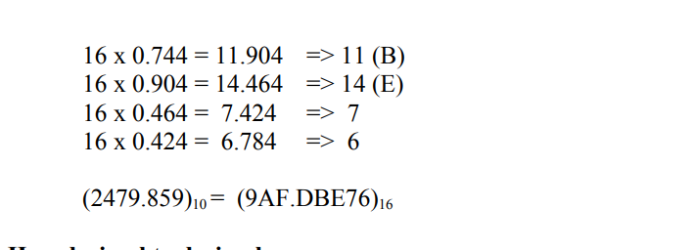
DECIMAL TO HEXADECIMAL NUMBER CONVERSION

Slide 38
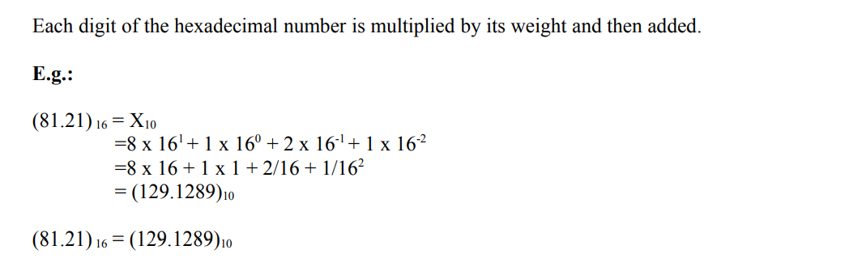
HEXADECIMAL TO DECIMAL NUMBER CONVERSION

Slide 39
I. CODES BINARY CODED DECIMAL
Binary-coded decimal is a system of writing numerals that assigns a four-digit binary code to each digit 0 through 9 in a decimal (base 10) number.
Simply put, binary-coded decimal is a way to convert decimal numbers into their binary equivalents.
However, binary-coded decimal is not the same as simple binary representation.

Slide 40
BINARY CODED DECIMAL
It is a form of binary encoding where each digit in a decimal number is represented in the form of bits
This encoding can be done in either 4-bit or 8-bit (usually 4-bit is preferred).
It is a fast and efficient system that converts the decimal numbers into binary numbers as compared to the existing binary system

Slide 41
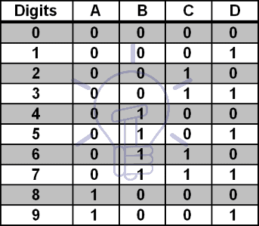
BINARY CODED DECIMAL – TRUTH TABLE

Slide 42
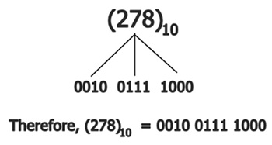
BINARY CODED DECIMAL
DECIMAL NUMBER BCD
0 0000
1 0001
2 0010
3 0011
4 0100
5 0101
6 0110
7 0111
8 1000
9 1001

Slide 43
Excess – 3 code
Excess-3 Code is a non-weighted BCD (8421) Code. Excess-3 Code is derived from 8421 code by adding 0011 (3) to all code groups.
It is a sequential code, thus can be also used for performing arithmetic operations. Also, Excess-3 codes are self-complementing codes in nature.
Therefore, subtraction by the method of complement addition is more direct in the XS-3 code than in 8421 BCD code.
Like, BCD code, it also has six invalid states which are: 0000, 0001, 0010, 1101, 1110 and 1111.

Slide 44
Excess – 3 code
Decimal Numbers | Binary Numbers | Excess-3 Code (Binary Number + 0011)
0 | 0000 | 0011
1 | 0001 | 0100
2 | 0010 | 0101
3 | 0011 | 1100
4 | 0100 | 0111
5 | 0101 | 1000
6 | 1010 | 1001
7 | 0111 | 1010
8 | 1000 | 1011
9 | 1001 | 1100

Slide 45
Excess – 3 code
Example:
Represent (1548)10 in Excess-3 notation.
1 = 0001 + 0011 = 0100
5 = 0101 + 0011 = 1000
4 = 0100 + 0011 = 0111
8 = 1000 + 0011 = 1011
(1548)₁₀ = 0100 1000 0111 1011 in XS-3 form

Slide 46
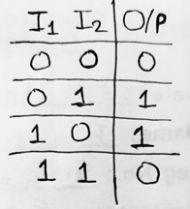
Gray code
The Gray Code is a non-weighted code and is cyclic as well.
It is referred to as cyclic because successive code words in this code differ by only one bit- position i.e., it is a unit distance code.
It is also reflective. In many practical applications such as analog to digital conversion, unit distance codes are used.
To convert Binary Code into Gray Code, one should have knowledge of truth table of XOR Gate which is as,

Slide 47
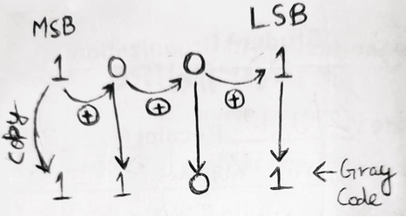
Gray code
Now, the MSB of the binary number is copied as it is and then we perform XOR operation for consecutive bits in a pair of two.
Example 1: Convert (1001)₂ into Gray Code
Therefore, (1001)₂ = (1101)_{g} in gray code.

Slide 48
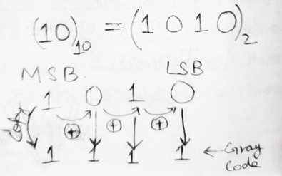
Gray code
Example 2: Convert (10)₁₀ into Gray Code
Firstly, we convert decimal number to binary number and then convert binary to gray code.
Therefore (10)₁₀ = (1111)_{g}

Slide 49
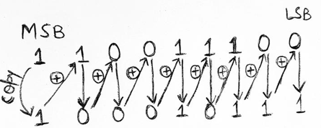
Gray code
Conversion of Gray Code into Binary Number
The MSB of Gray code is copied as it to be the MSB bit of binary number which is then XORed with the next bot of gray code, the result is recorded as the next bit of binary number, now this recorded bit is XORed with the next bit of gray code and this process is continued till the LSB is obtained.
Example 1: Convert (110011100)_{g} to binary number
Therefore, (110011100)_{g} = (10010111)₂

Slide 50
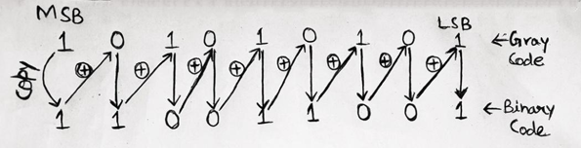
Gray code
Example 2: Convert (101010101)g to binary number
Therefore, (101010101)_{g} = (110011001)₂

Slide 51
ASCII CODES
Besides numerical data, computer must be able to handle alphabets, punctuation marks, mathematical operators, special symbols, etc. that form the complete character set of English language. The complete set of characters or symbols are called alphanumeric codes. The complete alphanumeric code typically includes −
26 upper case letters
26 lower case letters
10 digits
7 punctuation marks
20 to 40 special characters

Slide 52
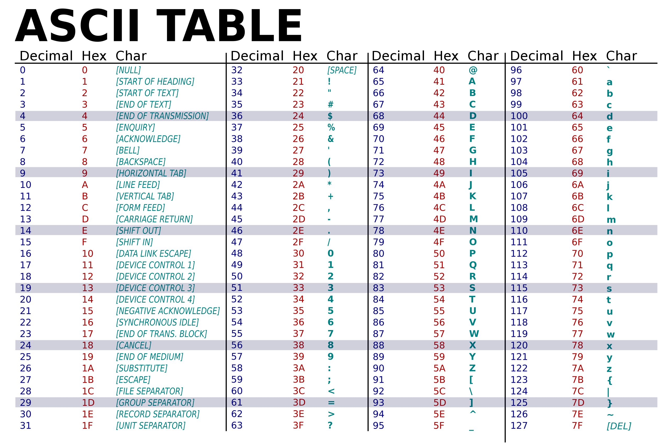

Slide 53
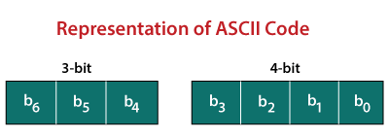
ASCII CODES
Now a computer understands only numeric values, whatever the number system used. So all characters must have a numeric equivalent called the alphanumeric code.
The most widely used alphanumeric code is American Standard Code for Information Interchange (ASCII). ASCII is a 7-bit code that has 128 (27) possible codes. ASCII was originally developed for basic computers and printers.

Slide 54
ASCII CODES - Example
Encode (10010101100001111011011000011010100111000011011111101001 110111011101001000000011000101100100110011)2 to ASCII.
Step 1 | The given binary data is grouped into 7-bits because the ASCII code is 7 bit.
Step 2 | Then, we find the equivalent decimal number of the binary digits either from the ASCII table or 64 32 16 8 4 2 1 scheme.

Slide 55
Binary | 64 | 32 | 16 | 8 | 4 | 2 | 1 | DECIMAL | ASCII
1100011 | 1 | 1 | 0 | 0 | 0 | 1 | 1 | 99 | C
1101111 | 1 | 1 | 0 | 1 | 1 | 1 | 1 | 111 | O
1101101 | 1 | 1 | 0 | 1 | 1 | 0 | 1 | 109 | M
1110000 | 1 | 1 | 1 | 0 | 0 | 0 | 0 | 112 | P
1110101 | 1 | 1 | 1 | 0 | 1 | 0 | 1 | 117 | U
1110100 | 1 | 1 | 1 | 0 | 1 | 0 | 0 | 116 | T
1100101 | 1 | 1 | 0 | 0 | 1 | 0 | 1 | 101 | E
1110010 | 1 | 1 | 1 | 0 | 0 | 1 | 0 | 114 | R
So the given binary digits results in ASCII Keyword COMPUTER

Slide 56
ASCII CODES
For example, the ASCII code for lower case z is 122 and is shown below:
The most significant bit was sometimes used as a parity bit to perform a parity check (a form of error checking). Other computers set the most significant bit to 0.
Parity Bit/Eighth Bit | 64 | 32 | 16 | 8 | 4 | 2 | 1
0 | 1 | 1 | 1 | 1 | 0 | 1 | 0

Slide 57
Parity Code
The parity code is used for the purpose of detecting errors during the transmission of binary information. The parity code is a bit that is included with the binary data to be transmitted.
The inclusion of a parity bit will make the number of 1’s either odd or even. Based on the number of 1’s in the transmitted data, the parity code is of two types.
Even parity code
Odd parity code
In even parity, the added parity bit will make the total number of 1’s an even number.
If the added parity bit make the total number of 1’s as odd number, such parity code is said to be odd parity code.

Slide 58
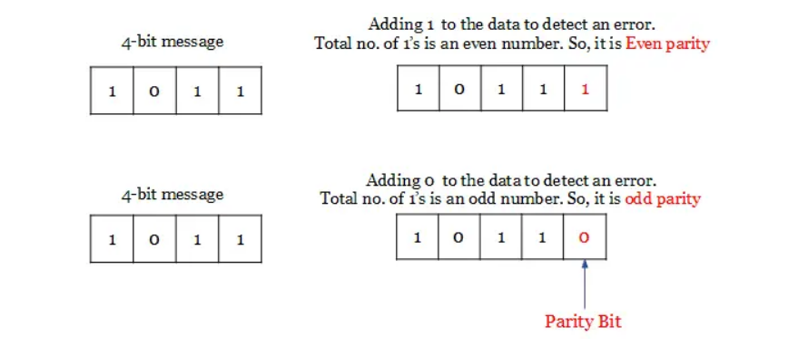
Parity Code

Slide 59
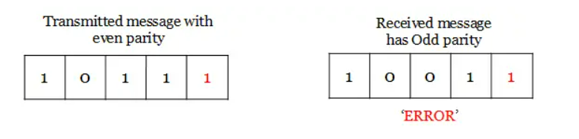
On the receiver side, if the received data is other than the sent data, then it is an error. If the sent date is even parity code and the received data is odd parity, then there is an error.
So, both even and odd parity codes are used only for the detection of error and not for the correction in the transmitted data. Even parity is commonly used and it has almost become a convention.

Slide 60
Advantages
Easy to implement
Simple method
Used error detection
Demerits
No error correction

Slide 61
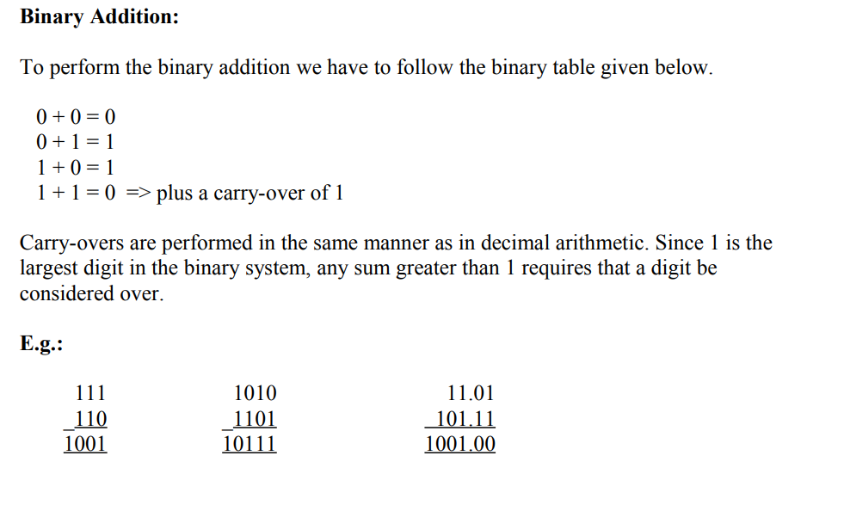
III. BINARY ARITHMETIC BINARY ADDITION

Slide 62
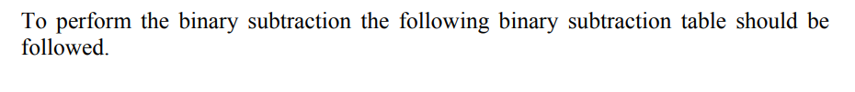

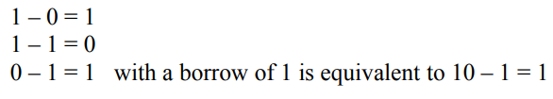
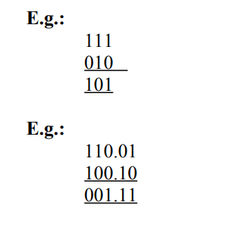
BINARY SUBTRACTION

Slide 63
REPRESENTING BINARY INTEGERS
A computer has to process both positive and negative numbers called signed integers and/or simply signed numbers
Binary integer number can be represented using one of the following schemes:
Signed – Magnitude representation
Signed – 1’s complement representation
Signed – 2’s complement representation
For instance consider -6 and +6
Considered Bit/ Number | Sign and Magnitude | 1’s Complement | 2’s Complement
 | 8421 | 8421 | 8421
+6 | 0110 | 0110 | 0110
-6 | 1110 | 1001 | 1010
 | Change the sign bit | Take 1’s complement | Take 2’s complement. Keep the LSB and first non zero number as it is. Flip the remaining bits

Slide 64
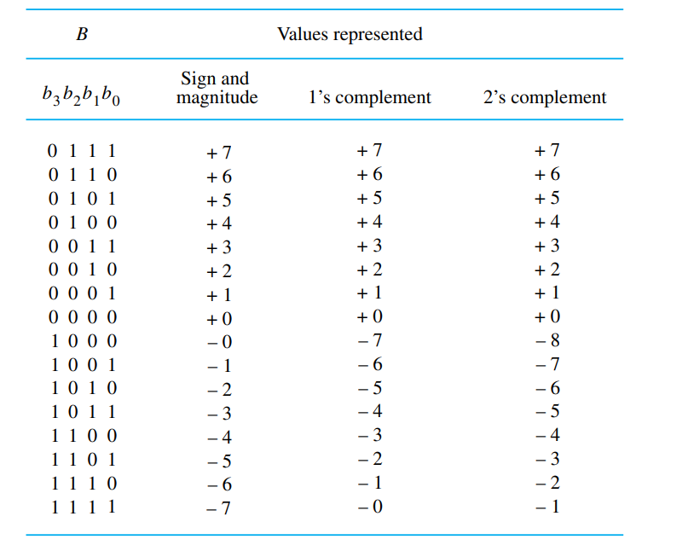
REPRESENTING BINARY INTEGERS

Slide 65
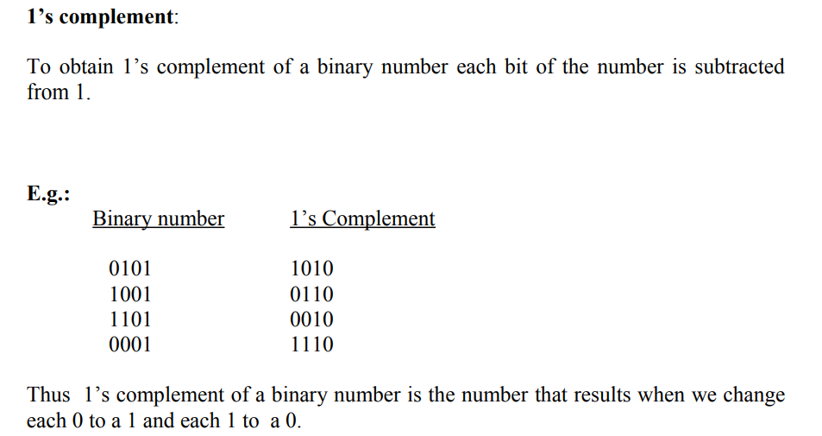
1’S COMPLEMENT

Slide 66
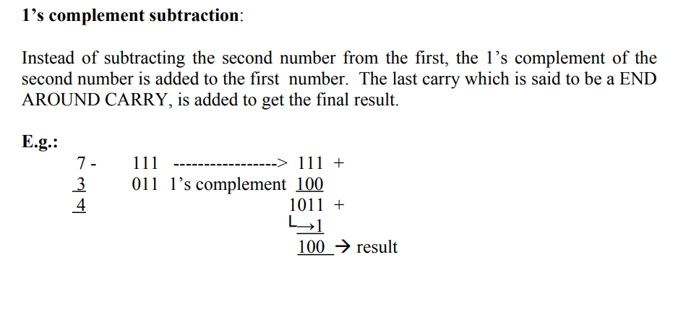
1’S COMPLEMENT SUBTRACTION

Slide 67
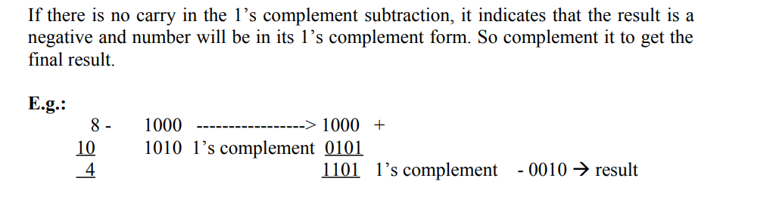
1’S COMPLEMENT SUBTRACTION

Slide 68
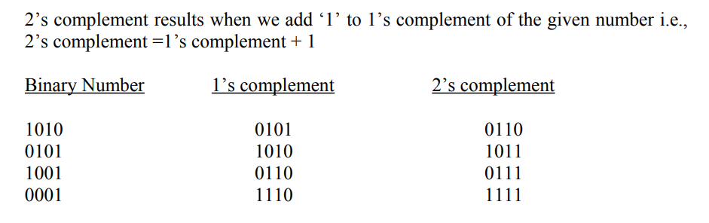
2’S COMPLEMENT

